Slide 1
Virtual reality school

Slide 2
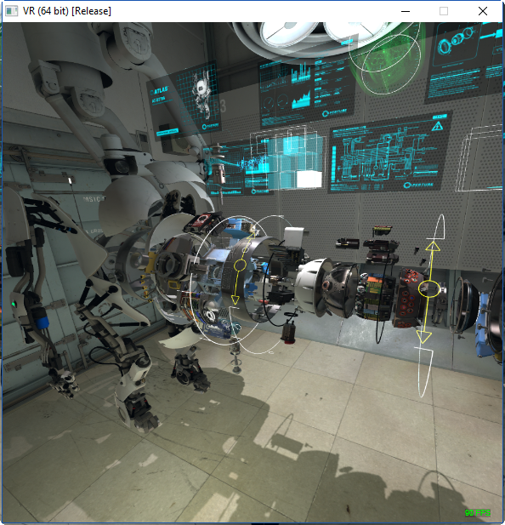
Experience

Slide 3
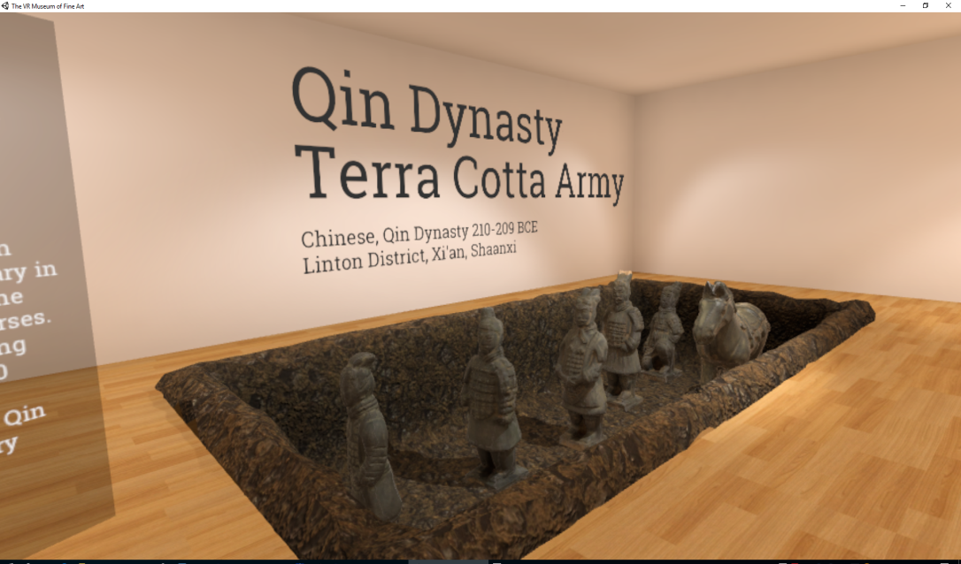
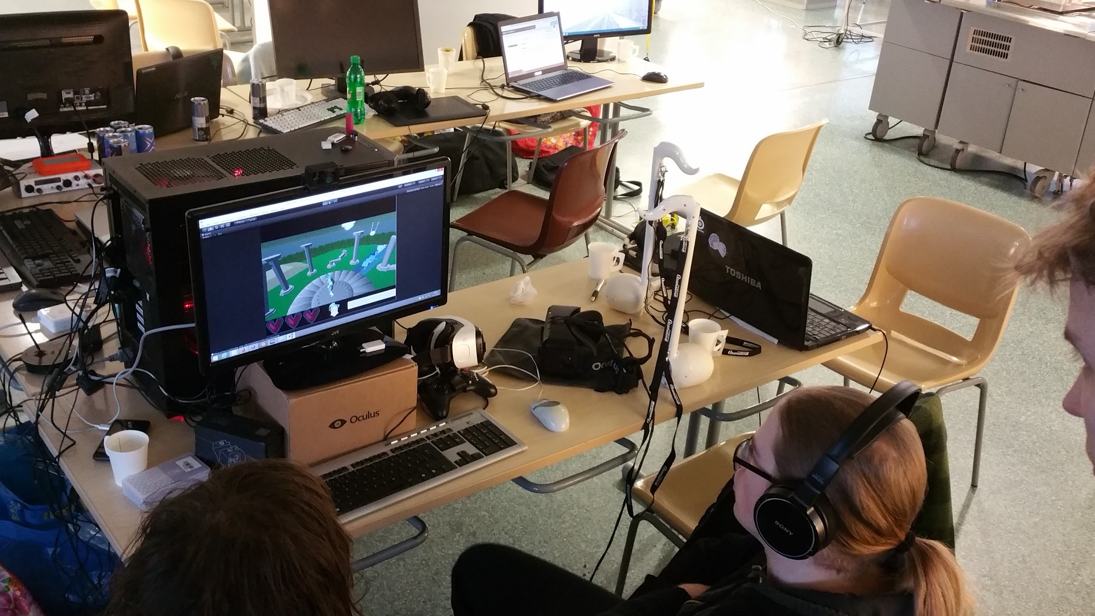
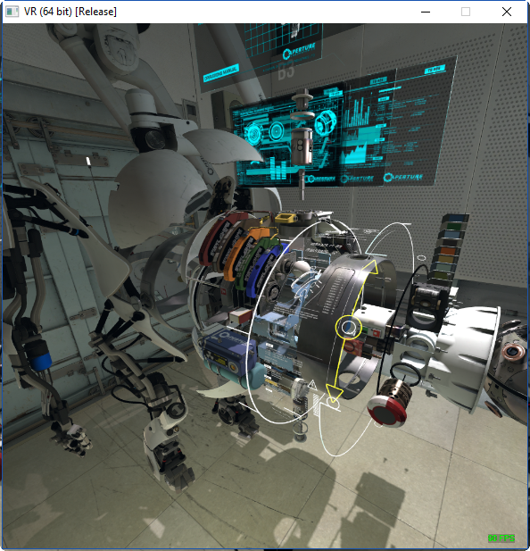
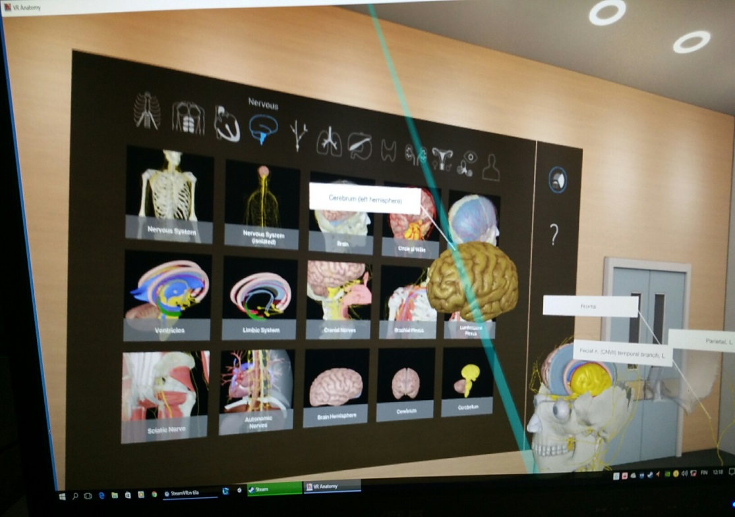
VR in learning

Slide 4
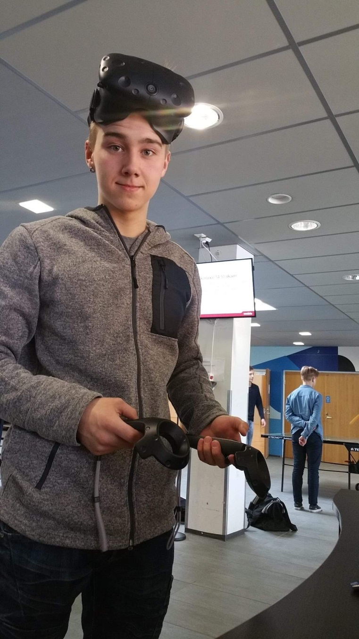
In our schools students produce VR material

Slide 5
Thank you !
High school student Aaron Siljander
High school student Tuomas Alanen
Coordinator Aki Puustinen @apuustin
+358407616178
Coordinator Timo Ilomäki @ilotimo
+358407209100
Coordinator Jukka Sormunen @sormuju
+358447184542
fineduvr@gmail.com
http://fineduvr.fi/

